Slide 1
Optimizing Flight Navigation: Enhancing Route Planning and Mitigating Risks

Slide 2
Team Name - AeroXcel
Team members
Anish Gupta
Vinay Tare
Rohit rana
Ishani Bhatia

Slide 3
Problem Statement
Our main goal is to craft a sturdy software solution that harnesses existing algorithms. This solution will pinpoint the best flight paths while factoring in various challenges. Furthermore, it will offer real-time risk assessments and propose alternate routes to ensure safety and efficiency for pilots, airlines, and airport authorities. Additionally, integrating a real-time health metrics tracker based on flight sensor data will enhance understanding of flight health.

Slide 4
SOLUTION
Route Planning Algorithm: We modified Dijkstra's algorithm to consider haversine distance and weather-based weights for optimal routes, ensuring risk minimization.
Impact Metrics: Metrics include reduced flight delays, incidents, improved fuel efficiency, and user feedback for effectiveness.
Tool & Technologies: Leveraging NodeJS, ExpressJS, MongoDB, and ReactJS for robust backend, frontend, and data management.
Assumptions, Constraints, and Solution Decision Points: We assumed accurate data from open sources, faced constraints on weather forecast accuracy, and chose NodeJS for its non-blocking architecture.
Implementation and Effectiveness: Our structured approach covers data management, algorithm implementation, UI design, and comprehensive documentation for effective implementation.
Scalability/Usability: With NodeJS clustering, MongoDB sharding, and ReactJS for intuitive UI, our solution scales horizontally and ensures usability.

Slide 5
Key Components and Requirements
Data Collection and Management
Continuous Data Collection: Gather data from open sources or create sample datasets encompassing factors affecting ﬂight navigation.
Structured Database: Store data in a structured manner and expose it via APIs for easy access and integration.
APIs for Sample Datasets: Utilize APIs from sources such as Aviation Stack, FlightAware, NOAA National Weather Service, OpenWeatherMap, NASA EOSDIS, FAA NOTAMs, ADS-B Exchange, and Kaggle.
Scenario Identiﬁcation
Risk and Challenge Identiﬁcation: Document various scenarios based on collected data, highlighting potential risks and challenges during ﬂight navigation.
Comprehensive Coverage: Address a wide range of factors including weather conditions, visibility issues, electronic failures, and other environmental variables.
Route Planning Algorithm
Algorithm Implementation: Use existing route planning algorithms or develop new ones to determine the best navigation paths.

Slide 6
Key Components and Requirements - Continued
Safety and Efﬁciency: Prioritize safety, efﬁciency, and reliability in route selection.
4. User Interface and Dashboard
User-Friendly Interface: Develop an interface that displays optimal ﬂight routes along with associated risks and challenges.
Real-Time Dashboard: Provide real-time updates and alerts on weather conditions, environmental factors, and system status to aid decision-making.

Slide 7
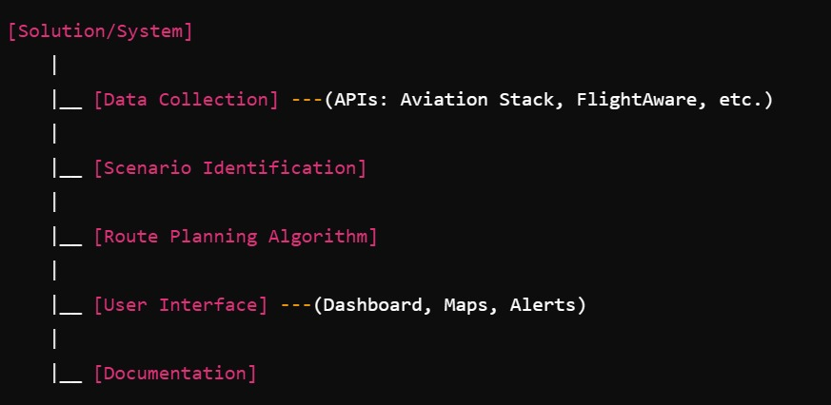
Methodology

Slide 8
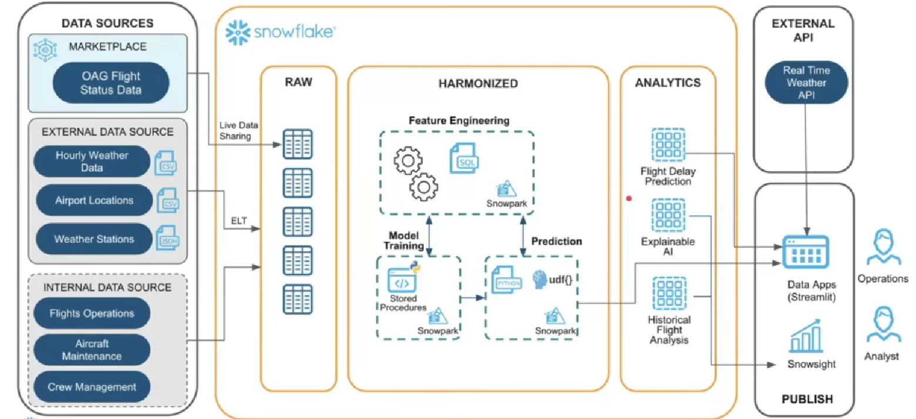
Architecture

Slide 9
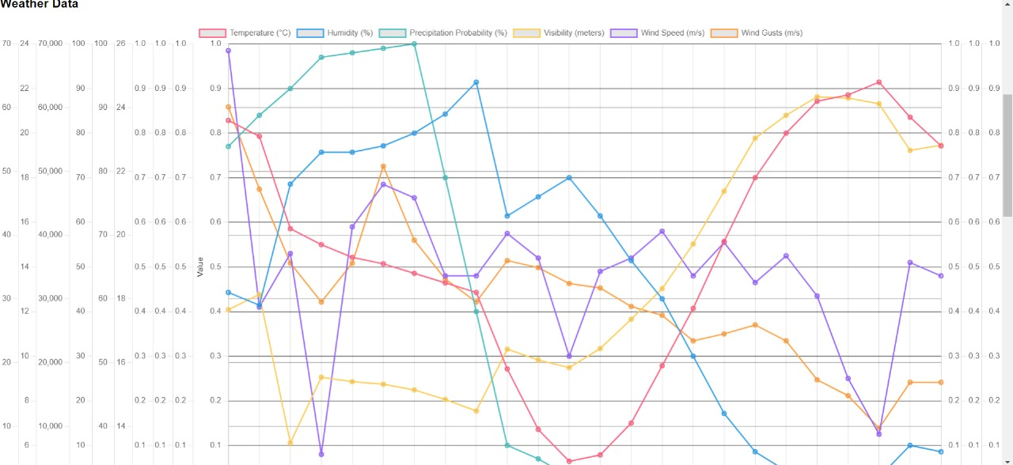
User Interface

Slide 10
Link to Github repository
https://github.com/Anishguptaprog/AIRBUS-Aerothon

Slide 11
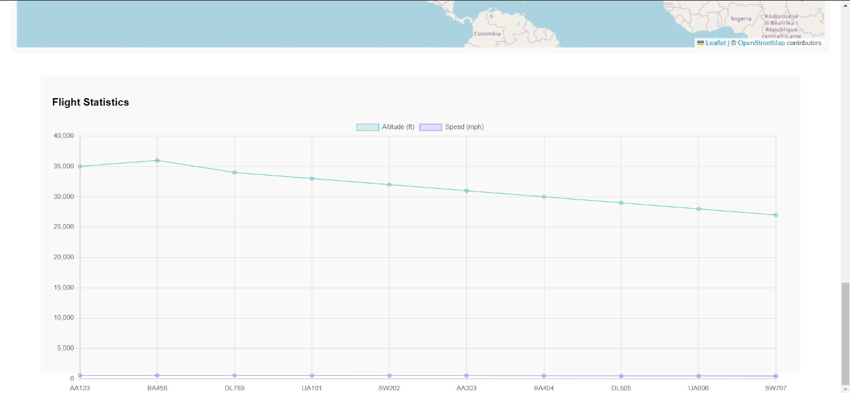
User Interface Continued

Slide 12
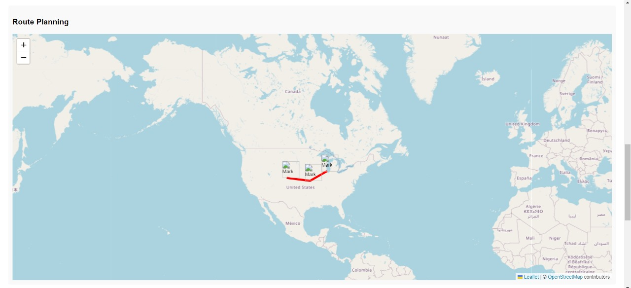
User Interface Continued

Slide 13
Thanks!

